Slide 1
C# & Visual Studio Fundamentals
Microsoft Student Technical Community, Vellore

Slide 2
What is .NET?

Slide 3

.NET
.NET is a free, cross-platform, open source developer platform for building many different types of applications.
With .NET, you can use multiple languages, editors, and libraries to build for web, mobile, desktop, gaming, and IoT.

Slide 4
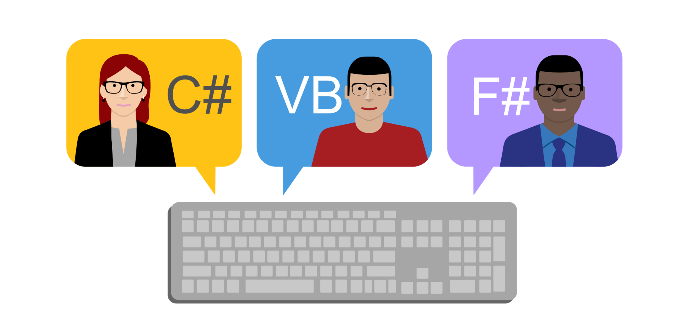
Languages
You can write .NET apps in C#, F#, or Visual Basic.
C# is a simple, modern, object-oriented, and type-safe programming language.
F# is a cross-platform, open-source, functional programming language for .NET. It also includes object-oriented and imperative programming.
Visual Basic is an approachable language with a simple syntax for building type-safe, object-oriented apps.

Slide 5

C#
VB
F#
C++
Visual Studio
Common Language Specification
.NET
.NET Base Class Library
Common Language Runtime

Slide 6

Cross Platform
Whether you're working in C#, F#, or Visual Basic, your code will run natively on any compatible OS. Different .NET implementations handle the heavy lifting for you:
.NET Core is a cross-platform .NET implementation for websites, servers, and console apps on Windows, Linux, and macOS.
.NET Framework supports websites, services, desktop apps, and more on Windows.
Xamarin/Mono is a .NET implementation for running apps on all the major mobile operating systems.

Slide 7

One consistent API
.NET Standard is a base set of APIs that are common to all .NET implementations.
Each implementation can also expose additional APIs that are specific to the operating systems it runs on. For example, .NET Framework is a Windows-only .NET implementation that includes APIs for accessing the Windows Registry.

Slide 8

Libraries
To extend functionality, Microsoft and others maintain a healthy package ecosystem built on .NET Standard.
NuGet is a package manager built specifically for .NET that contains over 90,000 packages.

Slide 9
Application Models

Slide 10
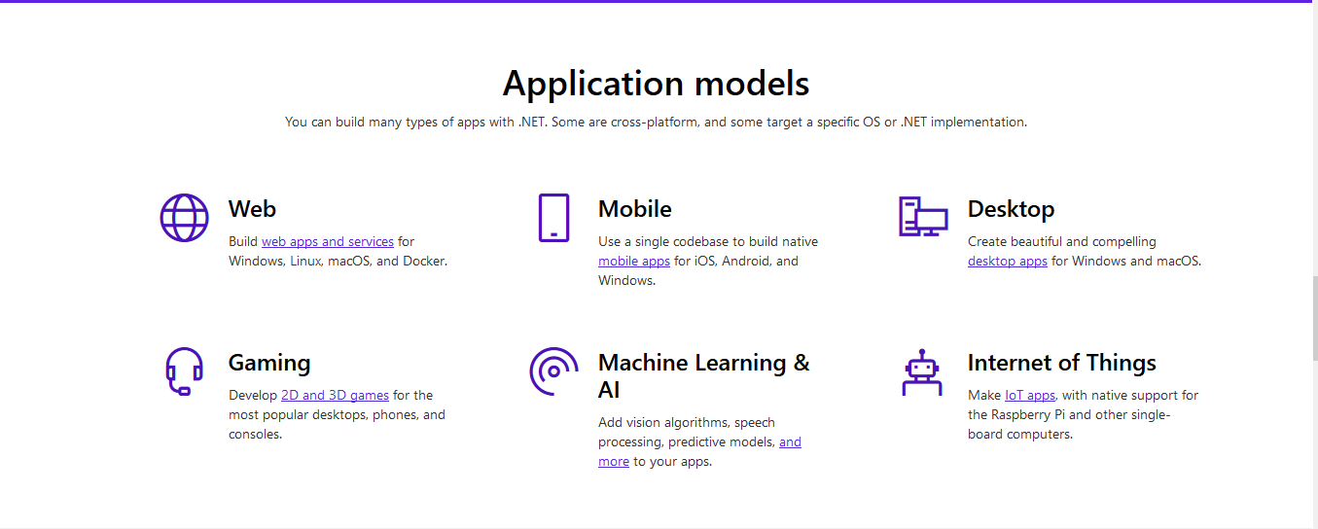

Slide 11
Intro to C#

Slide 12

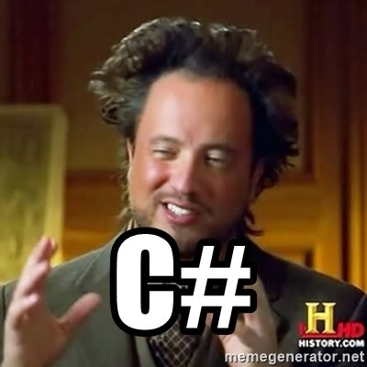
Key Points
C# is a pure object-oriented programming language developed by Microsoft
C# is the primary language for building software and services using .NET
C# has tons of powerful built-in features that replaces boilerplate code from languages like Java.
C# is now cross-platform thanks .NET Core which allows you to deploy applications on Mac and Linux.

Slide 13


Slide 14
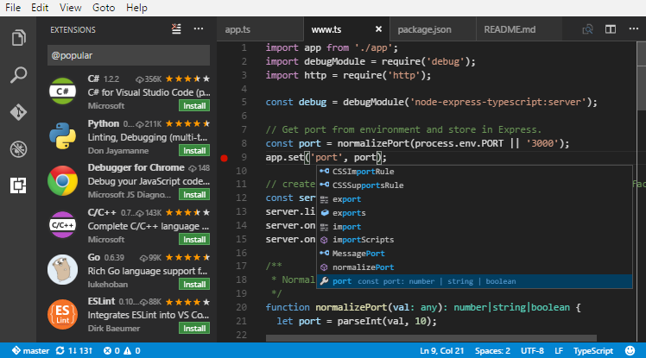
Let’s learn some C#
Install .NET Core SDK and Visual Studio Code. You can use any other code editor
You can also follow along by going to dotnetfiddle.net but you’d need internet
We’ll walk through some very basic C# code. There’s much, much more than this but don’t feel overwhelmed — we all have to start from somewhere.
Let’s get going!

Slide 15
bit.ly/QUICKDOTNET

Slide 16
extension methods
cross-platform
nullable types
LINQ
delegates
ref/out
events
unsafe code execution
async/await
lambdas
structs
properties
indexers
proper generics
`var` type inference
verbatim string
operator overloading
string interpolation
partial types

Slide 17
Type Inference
Java is a bit verbose when it comes to declaring variables
The diamond operator (<>) introduced in Java 7 reduce the amount of typing but it’s still repetitive
String name = "John";
FooClass<ArrayList<Integer>, ArrayList<Double>> obj =
new FooClass<ArrayList<Integer>, ArrayList<Double>>();
FooClass<ArrayList<Integer>, ArrayList<Double>> obj2 =
new FooClass<>();

Slide 18
Type Inference
C# provides type inference using the var keyword
In a nutshell, no more lengthy declarations!
var name = "John";
var obj = new FooClass<ArrayList<Integer>, ArrayList<Double>>();

Slide 19
Strings
Strings in Java are… messy
You need to escape \ in Java when you’re typing out paths or regular expressions
Creating strings with placeholders is also a bit… long-winded
String path = "D:\\Data\\db.json";
String.format("%s won %d points!", user, points);

Slide 20
Strings
String path = @"C:\Data\db.json";
verbatim strings in C# allows you to type strings that don’t parse the backslash as an escape sequence, i.e, no more double-slashing!
string interpolation allows you to type Strings with placeholder variables to be inserted in between.
No more frustrations when typing out paths or regular expressions! Win!
var text =
$"{user} won {points} points!";

Slide 21
Properties
private int num;
int getNum() {
return num;
}
int setNum(value) {
num = value;
}
// ...
obj.setNum(10);
System.out.println(obj.getNum());
In Java, if we need to control access to a field, we need to implement custom getters/setters.
This is very repetitive and painful to do.
Some IDEs offer shortcuts to create these for you but they still bloat the code.

Slide 22
Properties
public int Num { get; set; }
// ...
obj.Num = 10;
Console.WriteLine(obj.Num);
Enter C# properties. See how simple they are?
C# takes care of declaring getters and setters for you and your code can look super-clean.
You can even have custom properties for restricting access to variables.
private int num;
public int Num {
get
{
return num;
}
}
public void incrementNum()
{
++num;
}
// ...
var obj = new MyClass();
//obj.Num = 10;
//obj.num = 10;
obj.incrementNum();
Console.WriteLine(obj.Num);

Slide 23
Operator Overloading
There is no operator overloading in Java
This means many intuitive functionalities can only be achieved through the use of methods in Java
This makes the code look very bloated and impacts readability
For example, see how you compare two strings in Java
String s1 = "hello";
String s2 = "hello";
if (s1.equals(s2)) {
System.out.println("They're equal!");
}

Slide 24
Operator Overloading
C# supports operator overloading and you can define them for your classes
This greatly reduces the amount of code and enhances readability
See how simple it is to compare two Strings in C#
String s1 = "hello";
String s2 = "world";
if (s1 == s2)
{
Console.WriteLine("They're equal!");
}

Slide 25
class ComplexType
{
public double i;
public double r;
public ComplexType(double imag, double real)
{
i = imag;
r = real;
}
public static ComplexType operator+(ComplexType a, ComplexType b)
{
var result = new ComplexType(0, 0);
result.i = a.i + b.i;
result.r = a.r + b.r;
return result;
}
}

Slide 26
var a = new ComplexType(1, 1.4);
var b = new ComplexType(2, 1.6);
var result = a + b;
Console.WriteLine("{0}+{1}i", result.r, result.i);

Slide 27



LINQ
LINQ stands for Language Integrated Query
A bunch of extension methods and libraries to the already powerful and feature-rich .NET library
Added in C# 3.0 and .NET Framework 3.5
Allows you to type SQL like query-syntax to filter objects, databases and even XML documents
Can support different databases by using LINQ-to-SQL or Entity Framework
LINQ

Slide 28
List<Author> authorsList = new List<Author> {
new Author(){ Name="Mahesh", Book="ADO.NET Programming",
Publisher="Wrox", Year=2007, Price=44.95 },
new Author(){ Name="Raj", Book="LINQ Cookbook",
Publisher="APress", Year=2010, Price=49.95 },
new Author(){ Name="Praveen", Book="XML Code",
Publisher="Microsoft Press", Year=2012, Price=44.95 }
};
// I want to see the "Name" and "Publisher" of the record where the "Price"
// is 44.95. How do I do this?

Slide 29
var authorQuery = from author in authorsList
where author.Price == 44.95
select new { author.Name, author.Publisher };
// In case of an anonymous type, a var must be used
foreach (var author in authorQuery)
{
Console.WriteLine("Name={0}, Publisher={1}", author.Name, author.Publisher);
}

Slide 30


Just the tip of the iceberg
C# is filled with lots more features that will make you more productive as a programmer
Visual Studio + C# =
Learning C# can allow you to target all of Microsoft’s solutions
C# is now cross-platform with .NET Core — you can run it on Linux and macOS

Slide 31

Visual Studio 2017
Let’s take a deep dive.

Slide 32
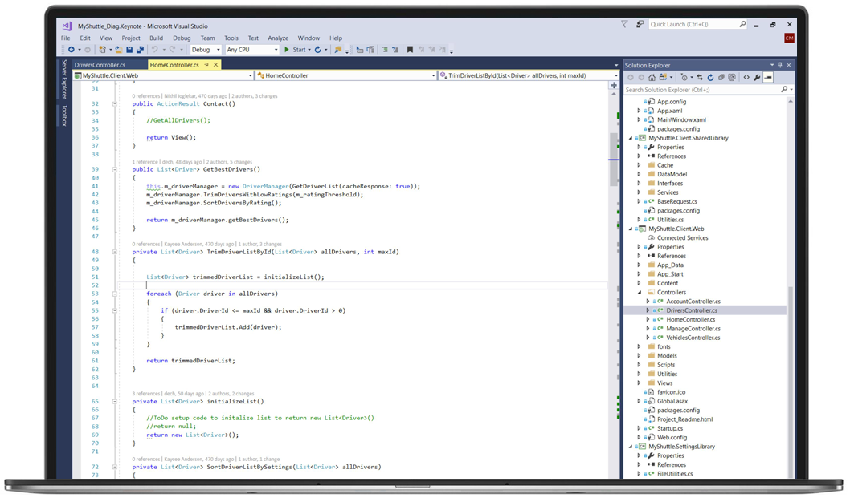
A powerful IDE
Visual Studio is an Integrated Development Environment (IDE)
One-stop tool for coding and building apps for the web, mobile, IoT, cloud and more
Available for both Windows and macOS
Has features for typing code faster, a rich debugging experience and a fast test & deployment pipeline for various platforms
Available for free via Community Edition

Slide 33
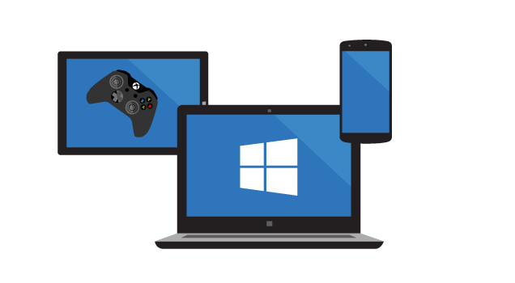





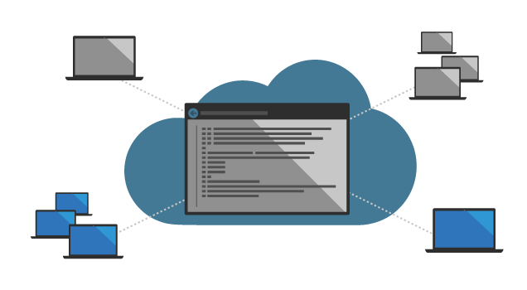
Visual Studio can do that?!
Notes:
Some cool shortcuts:
Peek definition (alt + f12)
Expand/shrink selection (ctrl + w, ctrl + shift + w)
Move line up/down (alt + up, alt + down)
Snippets (class, for, forr, try, tryf, ctor, cw)

Slide 35

Quantum Computing
A full-stack solution for quantum computing
Build for tomorrow’s computers using Q#
Leverage the .NET platform to combine your existing applications with Q# programs
Use Azure to build and scale your Quantum solutions
Get started — bit.ly/MSQuantum

Slide 36

Software Downloads
ASP.NET Core SDK — bit.ly/MSDCORE
Visual Studio Code — code.visualstudio.com/
Visual Studio 2017 — visualstudio.com/downloads/
Downloads for other platforms — microsoft.com/net/download/windows
For everything about the .NET platform, visit dot.net

Slide 37

mva.microsoft.com

Slide 38
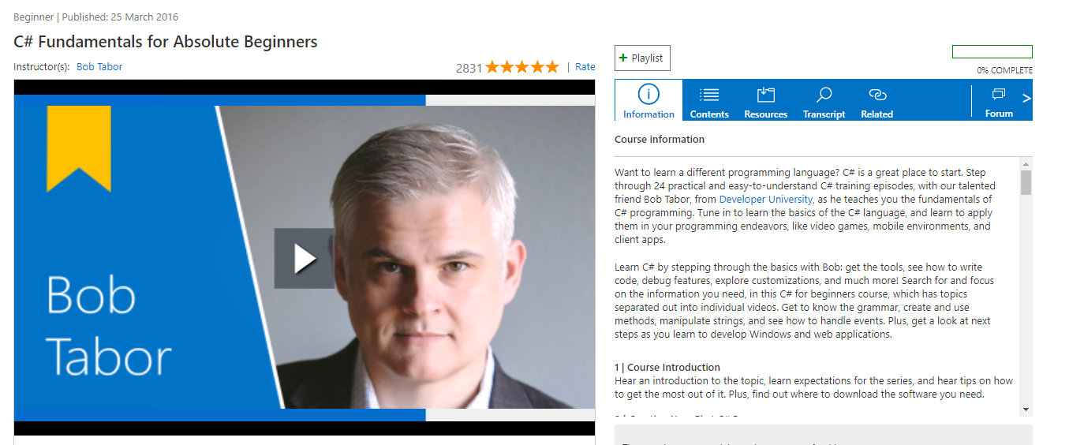
Learning C# and Visual Studio
bit.ly/MSCSFUND

Slide 39
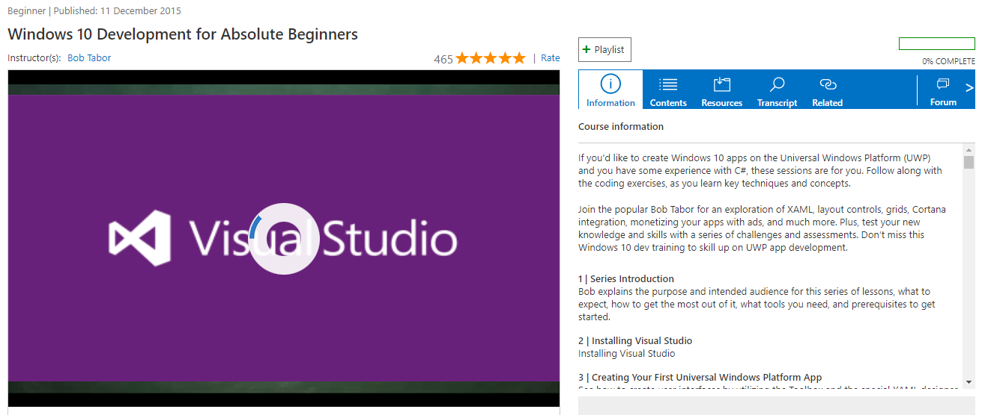
Build UWP apps
bit.ly/MSUWPTUT

Slide 40


Resources
Books
The C# Player’s Guide — R.B. Whitaker
C# in Depth — Jon Skeet
C# 6.0 and the .NET 4.6 Framework — Andrew Troelsen and Philip Japikse
Videos and Online
mva.microsoft.com
channel9.msdn.com
pluralsight.com
Mosh Hamedani’s excellent tutorials — programmingwithmosh.com

Slide 41
Some Tips
Lose the mouse and be more productive by mastering keyboard shortcuts, get this cheatsheet —visualstudioshortcuts.com/2017
Create an Imagine account and reap the benefits —imagine.microsoft.com/en-us/account
Create a developer account at my.visualstudio.com to access awesome free goodies like LinkedIn Learning, PluralSight, DataCamp and Xamarin University subscriptions. Level up!
Learn the keyboard shortcuts. Seriously.
Practice, practice, practice!

Slide 42

Imagine Cup
Submit creative projects and win upto $100K! Deadline for India National Finals is February 27th
Go to imagine.microsoft.com to get started

Slide 43




We’re here to help!
Follow us at fb.com/micvitvellore and github.com/mstcvit
Shoot us your questions about coding or upcoming events or just anything you wanna ask us!
We your feedback and so, keep it coming!

Slide 44



Stay awesome!
Thank you.
/micvitvellore
/mstcvit

